Slide 1




Inaudible Voice Commands: The Long-Range Attack and Defense
Nirupam Roy
Sheng Shen
Haitham Hassanieh
Romit Roy Choudhury
University of Illinois at Urbana-Champaign

Slide 2
50 million voice assistants are sold in US

Slide 3




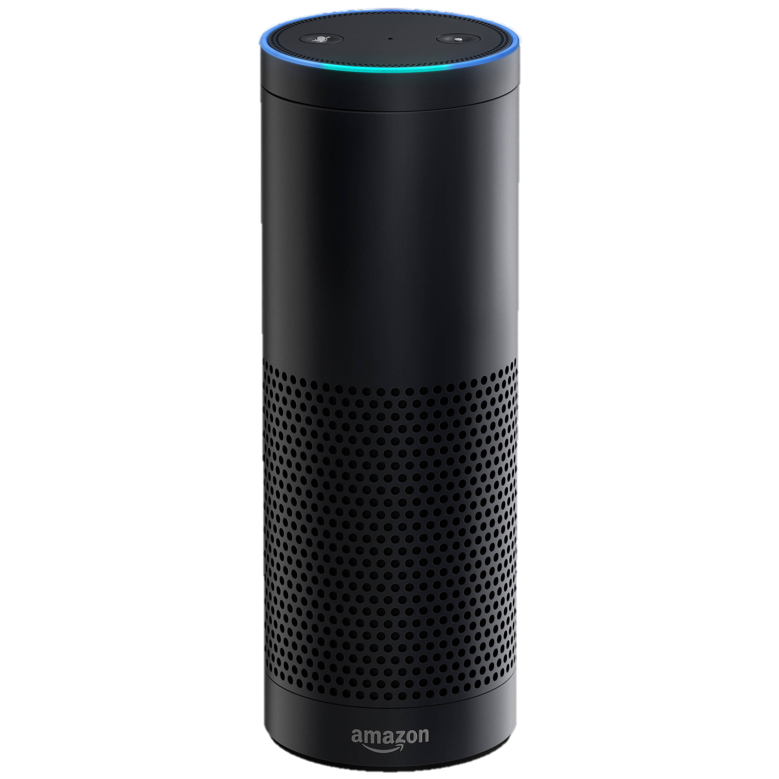


Inaudible Acoustics
Normal Sound
(< 24 kHz)
Ultrasound
(> 25 kHz)
“Inaudible Acoustics”
(> 25 kHz)
Ok
“Alexa, open the garage door!”

Slide 4
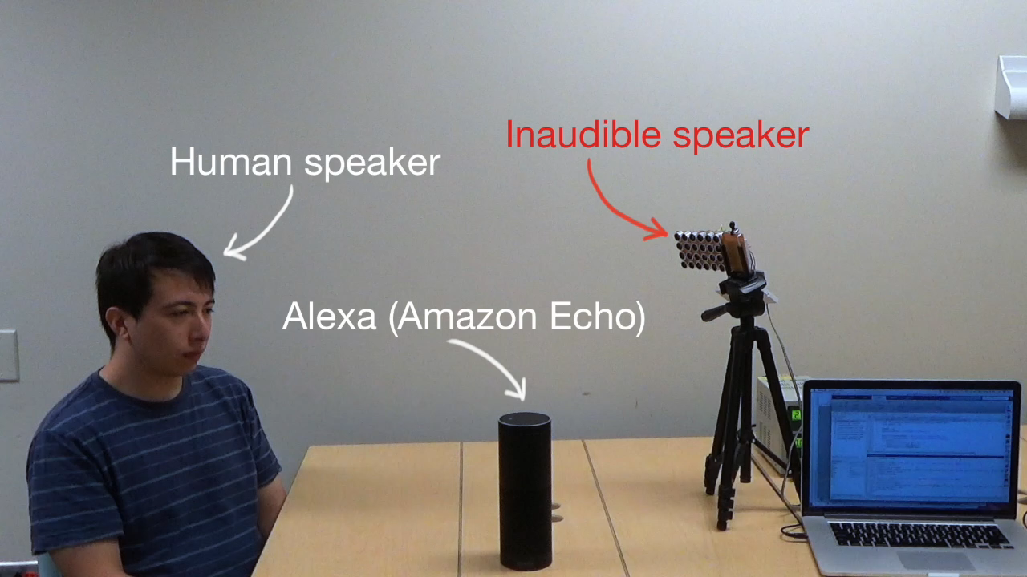

Inaudible Acoustics

Slide 5
Talk Outline
0. [BackDoor], [DolphinAttack], [Princeton Video]
MobiSys’17 (Best Paper)
CCS’17
arXiv

Slide 6
Talk Outline
0. [BackDoor], [DolphinAttack], [Princeton Video]
Today’s Talk:
1. How to launch long-range (realistic) attacks?
2. How to defend against these attacks?

Slide 7
Talk Outline
0. [BackDoor], [DolphinAttack], [Princeton Video]
Today’s Talk:
1. How to launch long-range (realistic) attacks?
2. How to defend against these attacks?

Slide 8
Amplitude
10k
20k
30k
40k
50k
60k
70k
80k
90k
100k
Microphone frequency spectrum
Diaphragm
Amplifier
Filter
ADC

Slide 9
Microphone
filter
Amplitude
10k
20k
30k
40k
50k
60k
70k
80k
90k
100k
Microphone frequency spectrum
Diaphragm
Amplifier
Filter
ADC

Slide 10
Microphone
filter
Amplitude
10k
20k
30k
40k
50k
60k
70k
80k
90k
100k
Microphone frequency spectrum
Diaphragm
Amplifier
Filter
ADC
Air Vibration → Electric Voltage

Slide 11
Output
Input
V_{out} = a₁V_{in}
Frequency
10k
20k
30k
40k
50k
60k
70k
80k
90k
100k
Diaphragm
Amplifier

Slide 12
Output
Output
Nonlinear
Input
Input
V_{out} = a₁V_{in}
V_{out} = a₁V_{in}+ a₂V_{in}² +...
Frequency
10k
20k
30k
40k
50k
60k
70k
80k
90k
100k
Diaphragm
Amplifier

Slide 13
Output
Output
Nonlinear
Input
Input
a₂V_{in}²
V_{out} = a₁V_{in}
V_{out} = a₁V_{in}+ a₂V_{in}² +...
Frequency
10k
20k
30k
40k
50k
60k
70k
80k
90k
100k
Diaphragm
Amplifier

Slide 15
Audible
Inaudible
Amplitude
Microphone
filter
10k
20k
30k
40k
50k
60k
70k
80k
90k
100k
Frequency

Slide 16
Audible
Inaudible
F₂
F₁
Amplitude
Microphone
filter
10k
20k
30k
40k
50k
60k
70k
80k
90k
100k
Frequency

Slide 17
Audible
Inaudible
F₂
F₁
Amplitude
Microphone
filter
10k
20k
30k
40k
50k
60k
70k
80k
90k
100k
Frequency
V_{out} = a₁V_{in}+ a₂V_{in}²
( sin F₁ + sin F₂ )²
= cos 2F₁
cos 2F₂
cos (F₁+F₂)
cos (F₁- F₂)
-
--
+

Slide 18
Audible
Inaudible
F₂
F₁
2F₂
(F₁+F₂)
2F₁
Amplitude
Microphone
filter
10k
20k
30k
40k
50k
60k
70k
80k
90k
100k
Frequency
V_{out} = a₁V_{in}+ a₂V_{in}²
( sin F₁ + sin F₂ )²
= cos 2F₁
cos 2F₂
cos (F₁+F₂)
cos (F₁- F₂)
-
--
+

Slide 19
Audible
Inaudible
F₂
F₁
2F₂
(F₁+F₂)
2F₁
Amplitude
Microphone
filter
10k
20k
30k
40k
50k
60k
70k
80k
90k
100k
Frequency
V_{out} = a₁V_{in}+ a₂V_{in}²
( sin F₁ + sin F₂ )²
= cos 2F₁
cos 2F₂
cos (F₁+F₂)
cos (F₁- F₂)
-
--
+

Slide 20
Audible
Inaudible
(F₁-F₂)
F₂
F₁
2F₂
(F₁+F₂)
2F₁
Amplitude
Microphone
filter
10k
20k
30k
40k
50k
60k
70k
80k
90k
100k
Frequency
V_{out} = a₁V_{in}+ a₂V_{in}²
( sin F₁ + sin F₂ )²
= cos 2F₁
cos 2F₂
cos (F₁+F₂)
cos (F₁- F₂)
-
--
+

Slide 21
Audible
Inaudible
(F₁-F₂)
F₂
F₁
Amplitude
Microphone
filter
10k
20k
30k
40k
50k
60k
70k
80k
90k
100k
Frequency

Slide 22


Audible
Inaudible
F₂
Amplitude
Microphone
filter
10k
20k
30k
40k
50k
60k
70k
80k
90k
100k
Frequency
V(t) = “Alexa, open the garage door!”

Slide 23
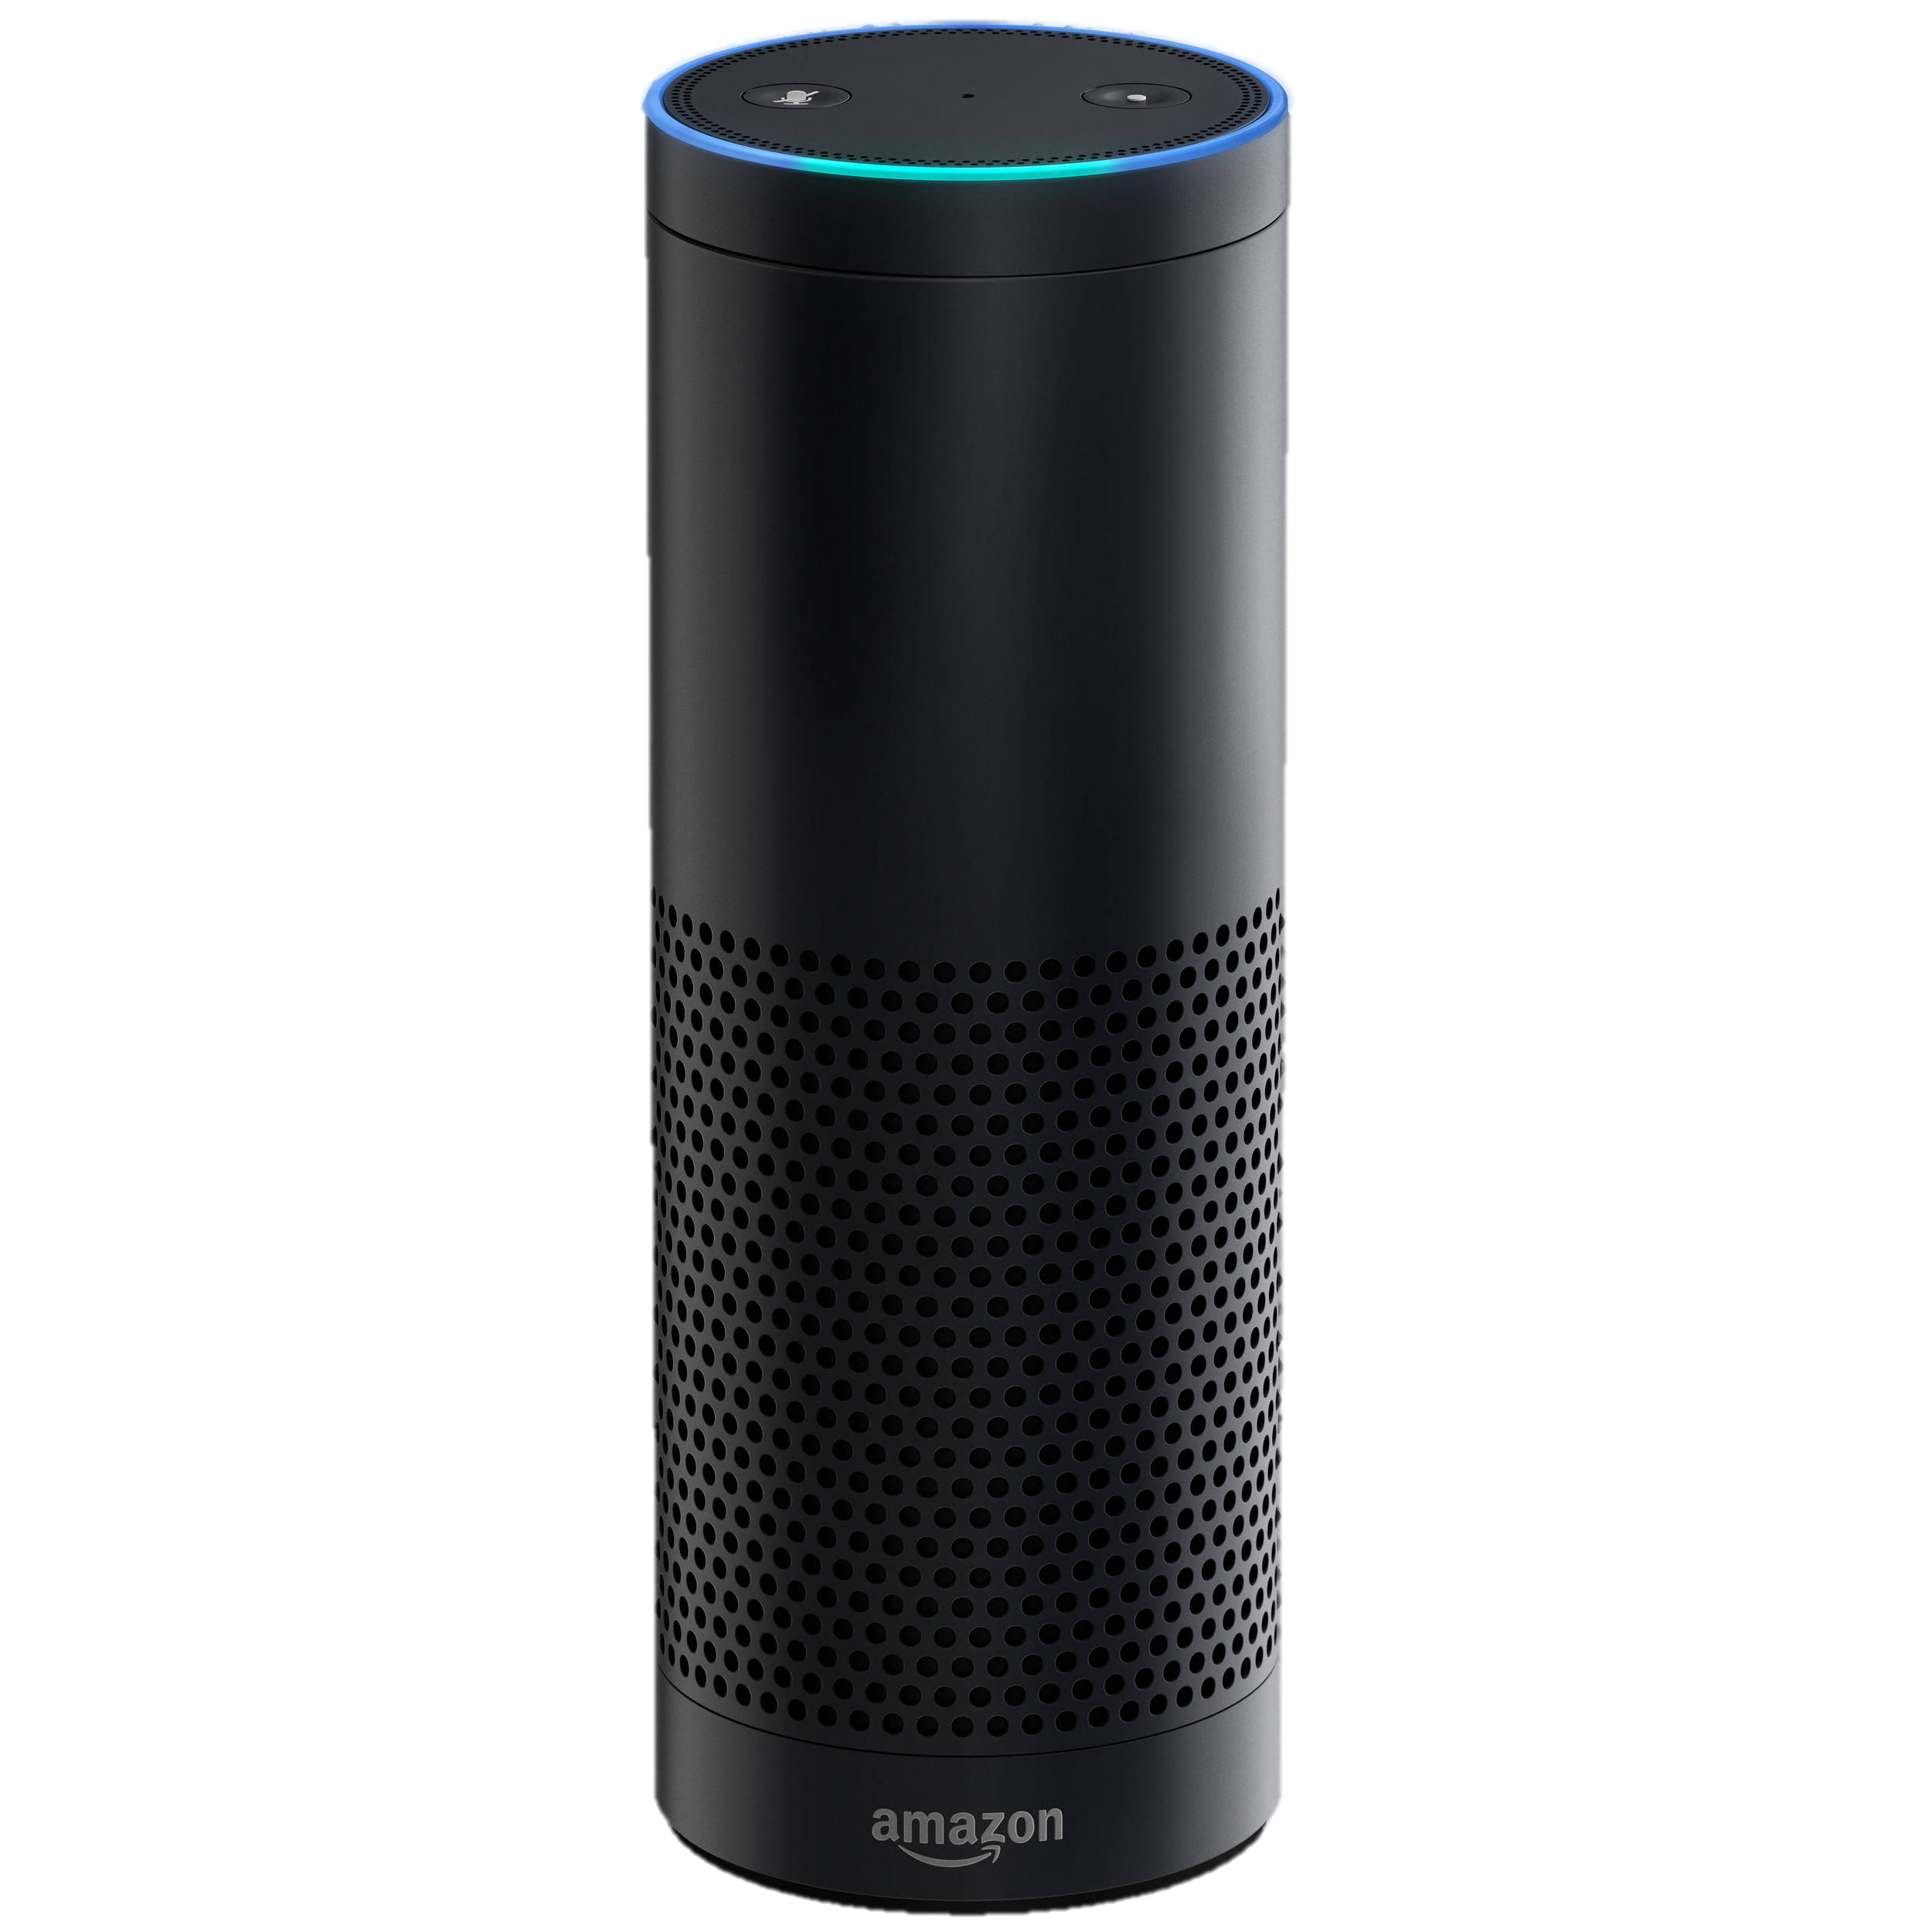
Audible
Inaudible
F₂
Amplitude
Microphone
filter
10k
20k
30k
40k
50k
60k
70k
80k
90k
100k
Frequency
Ok
V(t) = “Alexa, open the garage door!”

Slide 24
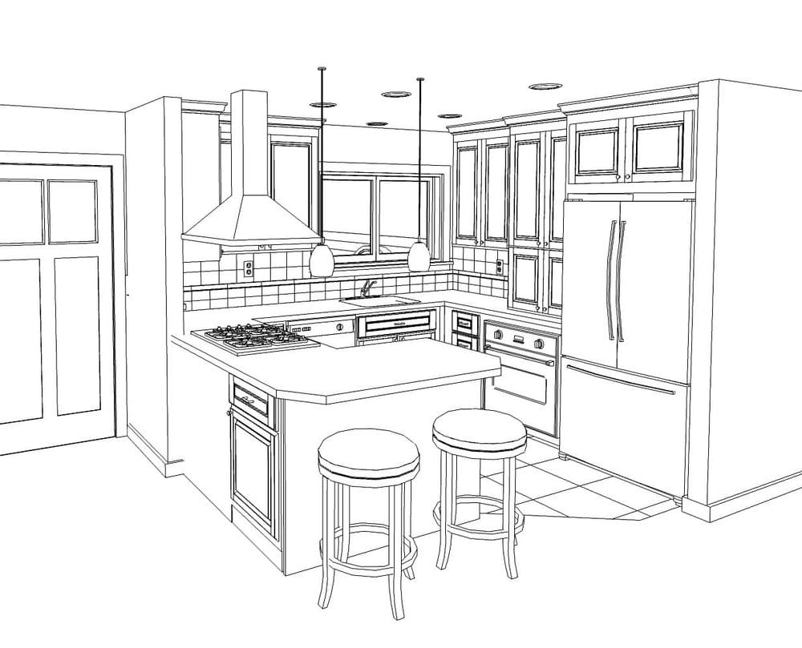
3-5 ft

Slide 25
Can someone attack from a longer range?

Slide 26





Can someone attack from a longer range?

Slide 27
Can someone attack from a longer range?
High power makes ultrasonic speakers audible

Slide 28

Speakers have nonlinearity too!

Slide 29
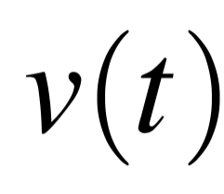
Voice Command:
Amplitude
Frequency
10k
20k
30k
40k
50k
60k
70k
80k
90k

Slide 30

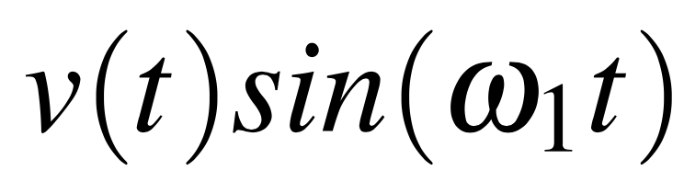
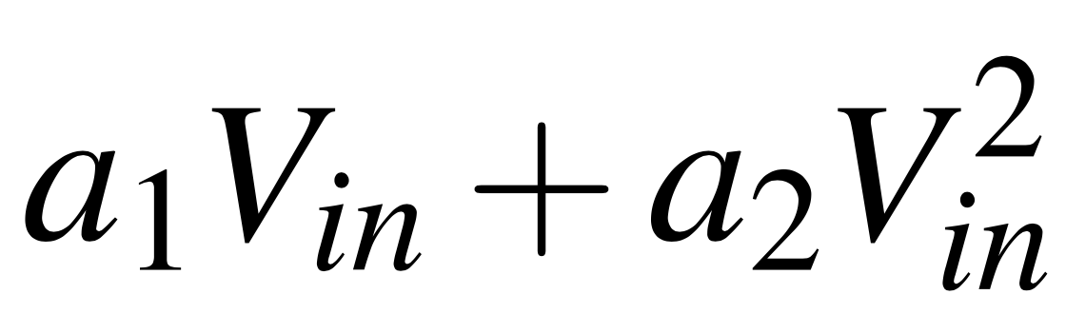
=
Amplitude
Frequency
10k
20k
30k
40k
50k
60k
70k
80k
90k
Speaker Nonlinearity

Slide 31
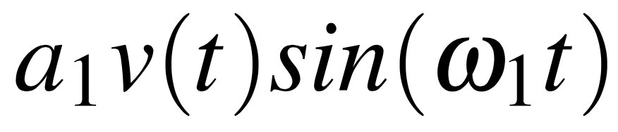
=
Amplitude
Frequency
10k
20k
30k
40k
50k
60k
70k
80k
90k
Speaker Nonlinearity
Amplitude
10k
20k
30k
40k
50k
60k
70k
80k
90k

Slide 32
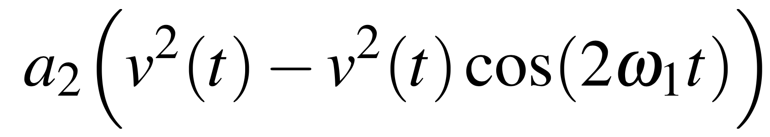
=
Amplitude
Frequency
10k
20k
30k
40k
50k
60k
70k
80k
90k
Speaker Nonlinearity
+
Amplitude
10k
20k
30k
40k
50k
60k
70k
80k
90k

Slide 33
=
Amplitude
Frequency
10k
20k
30k
40k
50k
60k
70k
80k
90k
Speaker Nonlinearity
General to all speakers!
Audible
Inaudible
Our Solution: “Leakage Optimization”
Amplitude
10k
20k
30k
40k
50k
60k
70k
80k
90k

Slide 34
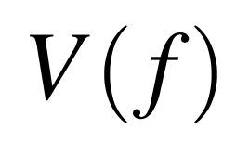

Speaker Nonlinearity → Audible Leakage
Speaker input
Amplitude
Bandwidth: B
Frequency
10k
20k
30k
40k
50k
60k
70k
80k
90k
100k
Speaker output
$$V\left(−f\right)∗V(f)$$
Amplitude
Bandwidth: B
Frequency
10k
20k
30k
40k
50k
60k
70k
80k
90k
100k

Slide 35

Speaker Nonlinearity → Audible Leakage
Speaker input
Amplitude
Frequency
10k
20k
30k
40k
50k
60k
70k
80k
90k
100k
Speaker output
Amplitude
Frequency
10k
20k
30k
40k
50k
60k
70k
80k
90k
100k

Slide 36
Speaker Nonlinearity → Audible Leakage
Speaker input
Amplitude
Frequency
10k
20k
30k
40k
50k
60k
70k
80k
90k
100k
Speaker output
Amplitude
Frequency
10k
20k
30k
40k
50k
60k
70k
80k
90k
100k

Slide 37
Speaker Nonlinearity → Audible Leakage
Speaker input
Amplitude
Frequency
10k
20k
30k
40k
50k
60k
70k
80k
90k
100k
Speaker output
Amplitude
Frequency
10k
20k
30k
40k
50k
60k
70k
80k
90k
100k

Slide 38
Speaker Nonlinearity → Audible Leakage
Speaker input
Amplitude
Frequency
10k
20k
30k
40k
50k
60k
70k
80k
90k
100k
Chopping compresses the leakage band
Speaker output
Amplitude
Frequency
10k
20k
30k
40k
50k
60k
70k
80k
90k
100k

Slide 39
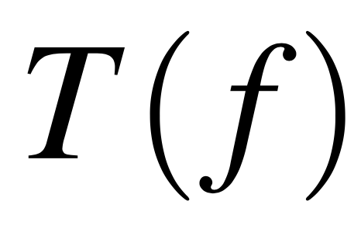





Leakage from Speaker
Speaker input
Human Hearing Threshold
$$T\left(f\right)$$
Amplitude
Audible
Inaudible
Minimum Gap
Frequency
10k
20k
30k
40k
50k
60k
70k
80k
90k
100k
$$L\left(f\right)$$
Speaker output
$$Maximize$$
$$\min_{f}{[T\left(f\right)−L(f)]}$$
Amplitude
$subject to f0≤$ $f1≤f2≤ …≤fN$
Frequency
10k
20k
30k
40k
50k
60k
70k
80k
90k
100k

Slide 40
Speaker input
Amplitude
Frequency
10k
20k
30k
40k
50k
60k
70k
80k
90k
100k
Speaker output
Amplitude
Frequency
10k
20k
30k
40k
50k
60k
70k
80k
90k
100k

Slide 41
Speaker input
Amplitude
Frequency
10k
20k
30k
40k
50k
60k
70k
80k
90k
100k
Speaker output
Inaudible
Amplitude
Frequency
10k
20k
30k
40k
50k
60k
70k
80k
90k
100k

Slide 42
Speaker input
F₂
Amplitude
Frequency
10k
20k
30k
40k
50k
60k
70k
80k
90k
100k
Speaker output
F₂
Inaudible
Amplitude
Frequency
10k
20k
30k
40k
50k
60k
70k
80k
90k
100k
Microphone output
Microphone
filter
F₂
Amplitude
Frequency
10k
20k
30k
40k
50k
60k
70k
80k
90k
100k

Slide 43
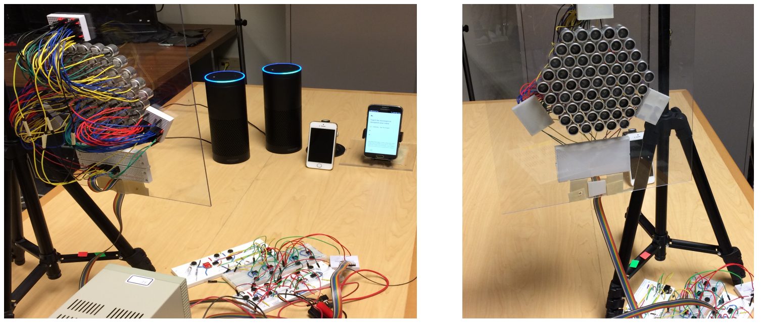
Evaluation

Slide 44
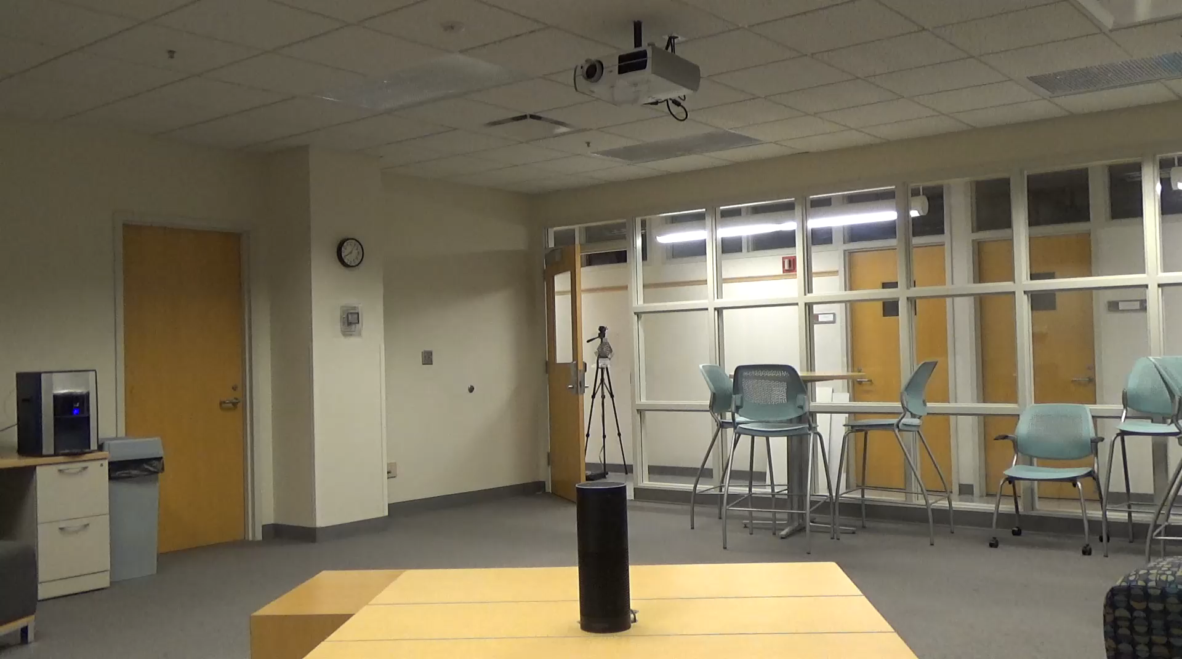
Inaudible voice commands: Long range
Inaudible voice command: Long range
Speaker array running leakage optimization
25 feet

Slide 45
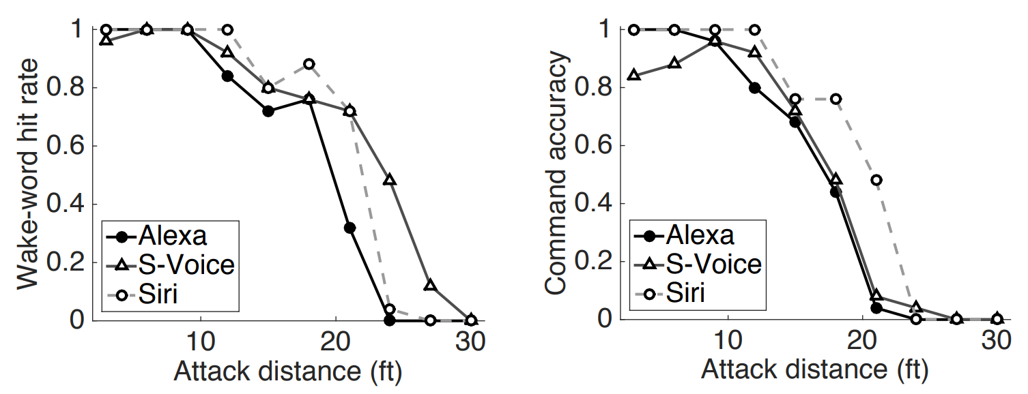
Evaluation
Wake-word hit rate

Slide 46
Evaluation
Wake-word hit rate
Command detection accuracy

Slide 47
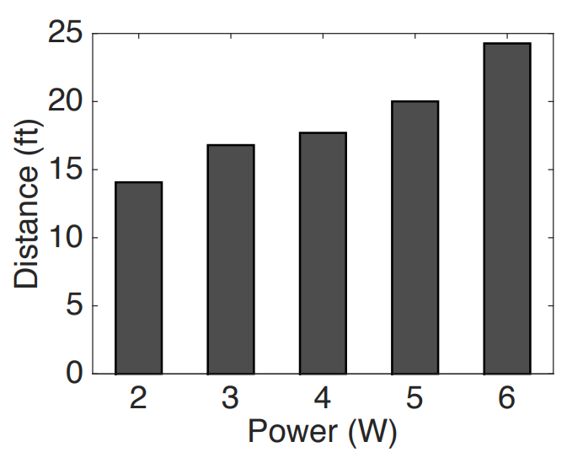
Evaluation
Maximum activation distance for different input power

Slide 48
Talk Outline
0. [BackDoor], [DolphinAttack], [Princeton Video]
Today’s Talk:
1. How to launch long-range (realistic) attacks?
2. How to defend against these attacks?

Slide 49
Talk Outline
0. [BackDoor], [DolphinAttack], [Princeton Video]
Today’s Talk:
1. How to launch long-range (realistic) attacks?
2. How to defend against these attacks?

Slide 50
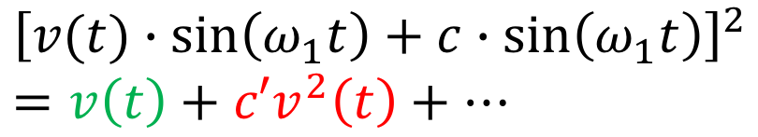
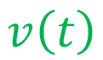
Core Question:
Is this a “non-linear signal” or normally recorded signal
Amplitude
10k
20k
30k
40k
50k
60k
70k
Frequency
Voice signal
$$v\left(t\right)$$
?
Inaudible Voice Attack
$${\left[v(t)∙\sin\left(ω_{1}t\right)+c∙\sin\left(ω_{1}t\right)\right]}^{2} \\ =v\left(t\right)+c′v^{2}\left(t\right)+⋯$$

Slide 51

Core Question:
Is this a “non-linear signal” or normally recorded signal
Voice signal
Amplitude
10k
20k
30k
40k
50k
60k
70k
Frequency
Nonlinear
distortion
$${\left[v(t)∙\sin\left(ω_{1}t\right)+c∙\sin\left(ω_{1}t\right)\right]}^{2}=v\left(t\right)+c′v^{2}\left(t\right)+⋯$$

Slide 52
Signal Forensics
Amplitude
10k
20k
30k
40k
50k
60k
70k
Frequency
Difficult to decouple “voice signal” and “non-linear signal”
Human voice signals present opportunities …

Slide 53
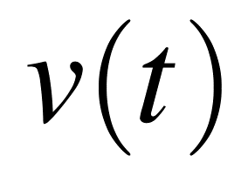
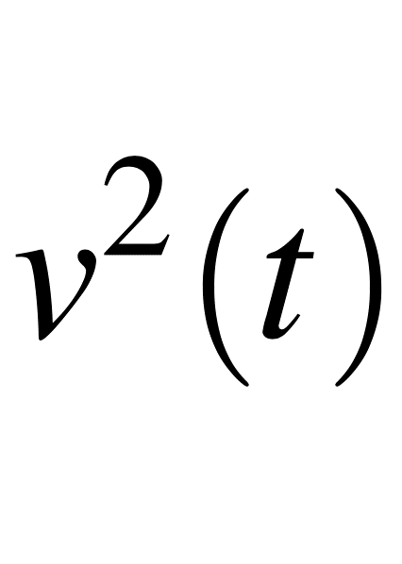
Opportunity #1: Voice > 50 Hz
Human Voice
f
2f
Amplitude
3f
4f
Frequency

Slide 54
Opportunity #1: Voice > 50 Hz
Human Voice
f
2f
Amplitude
3f
4f
Frequency
Energy at
sub-50Hz band

Slide 55
Opportunity #2: Correlation
Energy variation in v(t)
Ampl.
Time
Energy variation in v²(t)
Ampl.
Time
Correlation

Slide 56
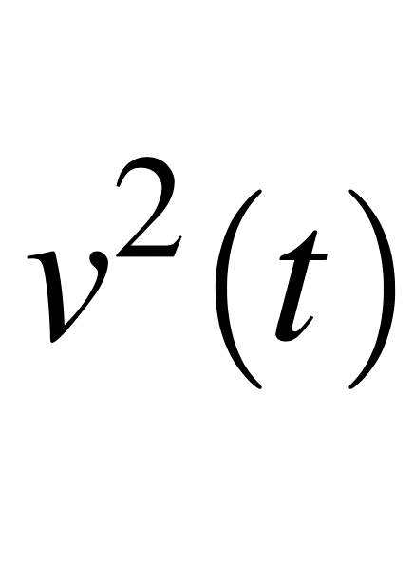
Opportunity #3: Amplitude Skewness
Amplitude
10k
20k
30k
40k
50k
60k
70k
Frequency
+
=
Amplitude skew

Slide 57
5000 Test Cases
Attack voice
Real voice

Slide 58
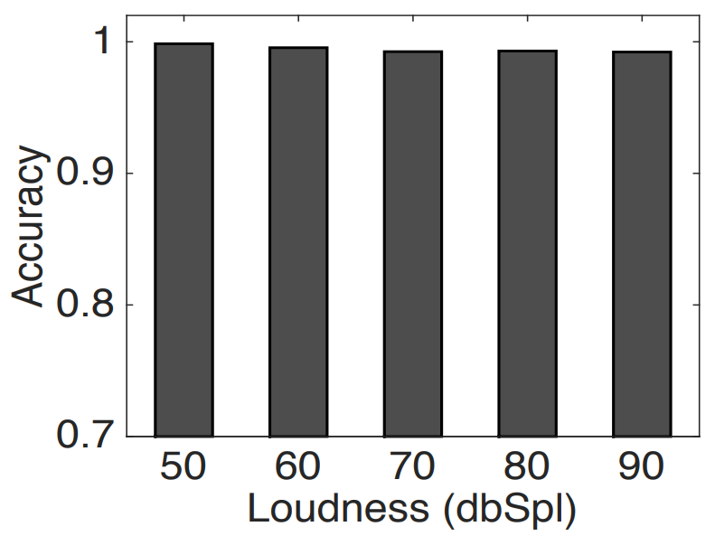
Overall Detection Accuracy

Slide 59

To summarize…
Inaudible Acoustics (> 25 kHz):
“Alexa, open the garage door!”
Ok
Ok
Ok

